Slide 1


Analyzing the relationship between personal/public health indicators and Cancer prevalence in 500 cities
Team 6:
Anyi Hu
Yu Wang
Saraswathi Sathees

Slide 2
Agenda
Data preprocessing
Fitting models
Models comparison
Dig into the best model

Slide 3
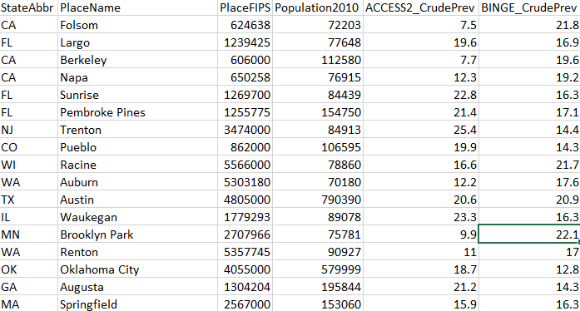
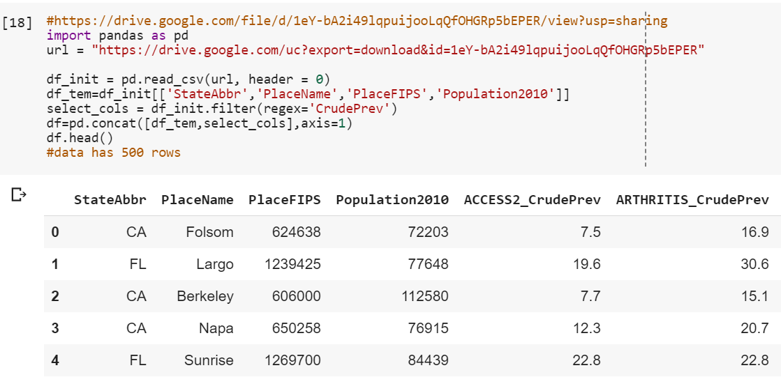
Data Wrangling
CSV file
No of rows - 500
No of Columns - 32
Loading Data

Slide 4
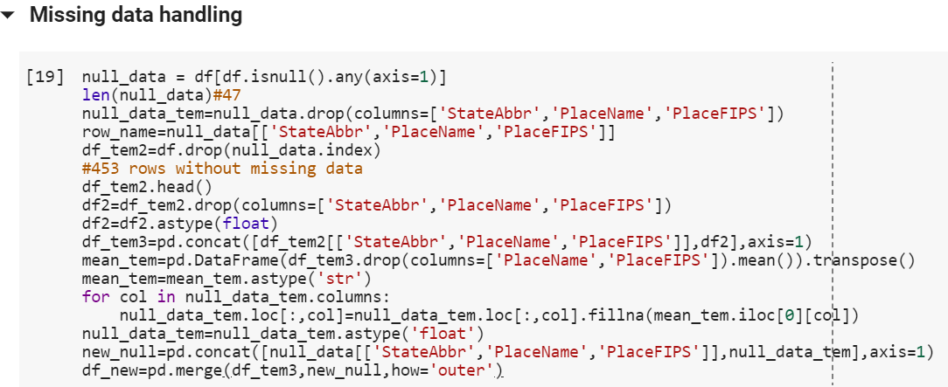
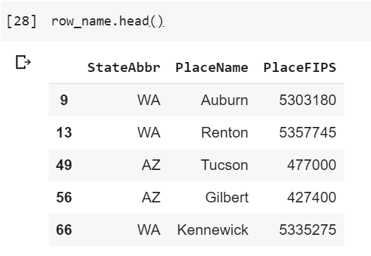
Missing Data Handling
Code Used
Rows having missing values

Slide 5
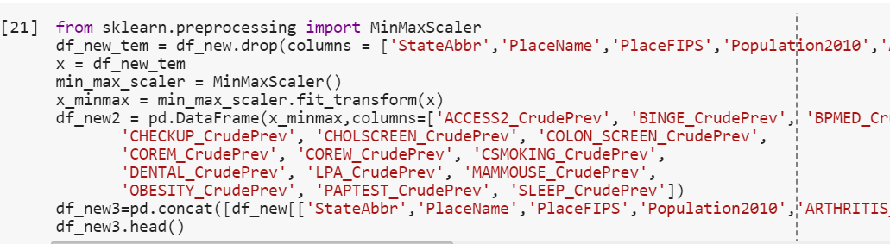
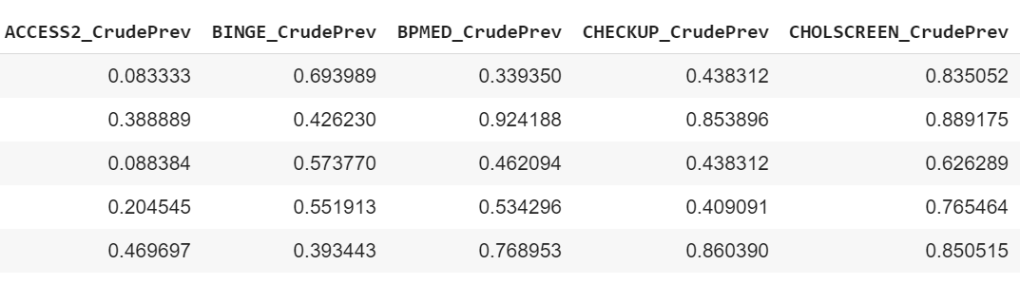
Data Standardization
Code Used
Results

Slide 6

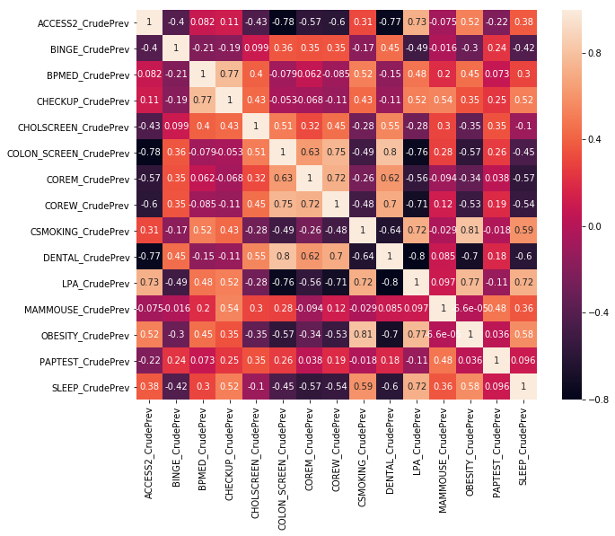
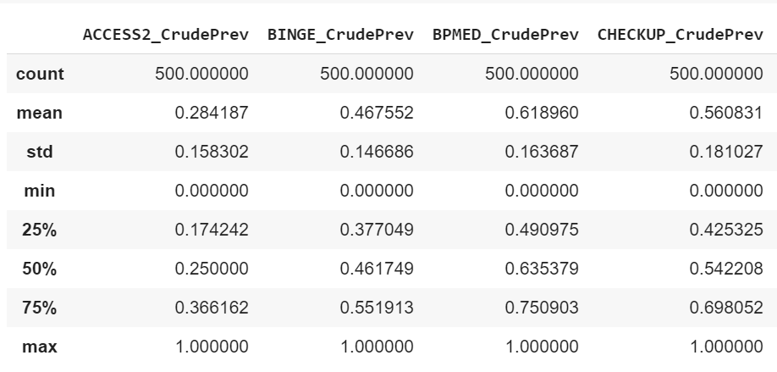
Exploratory Data Analysis
Correlation Matrix
Descriptive Statistics of the variables

Slide 7
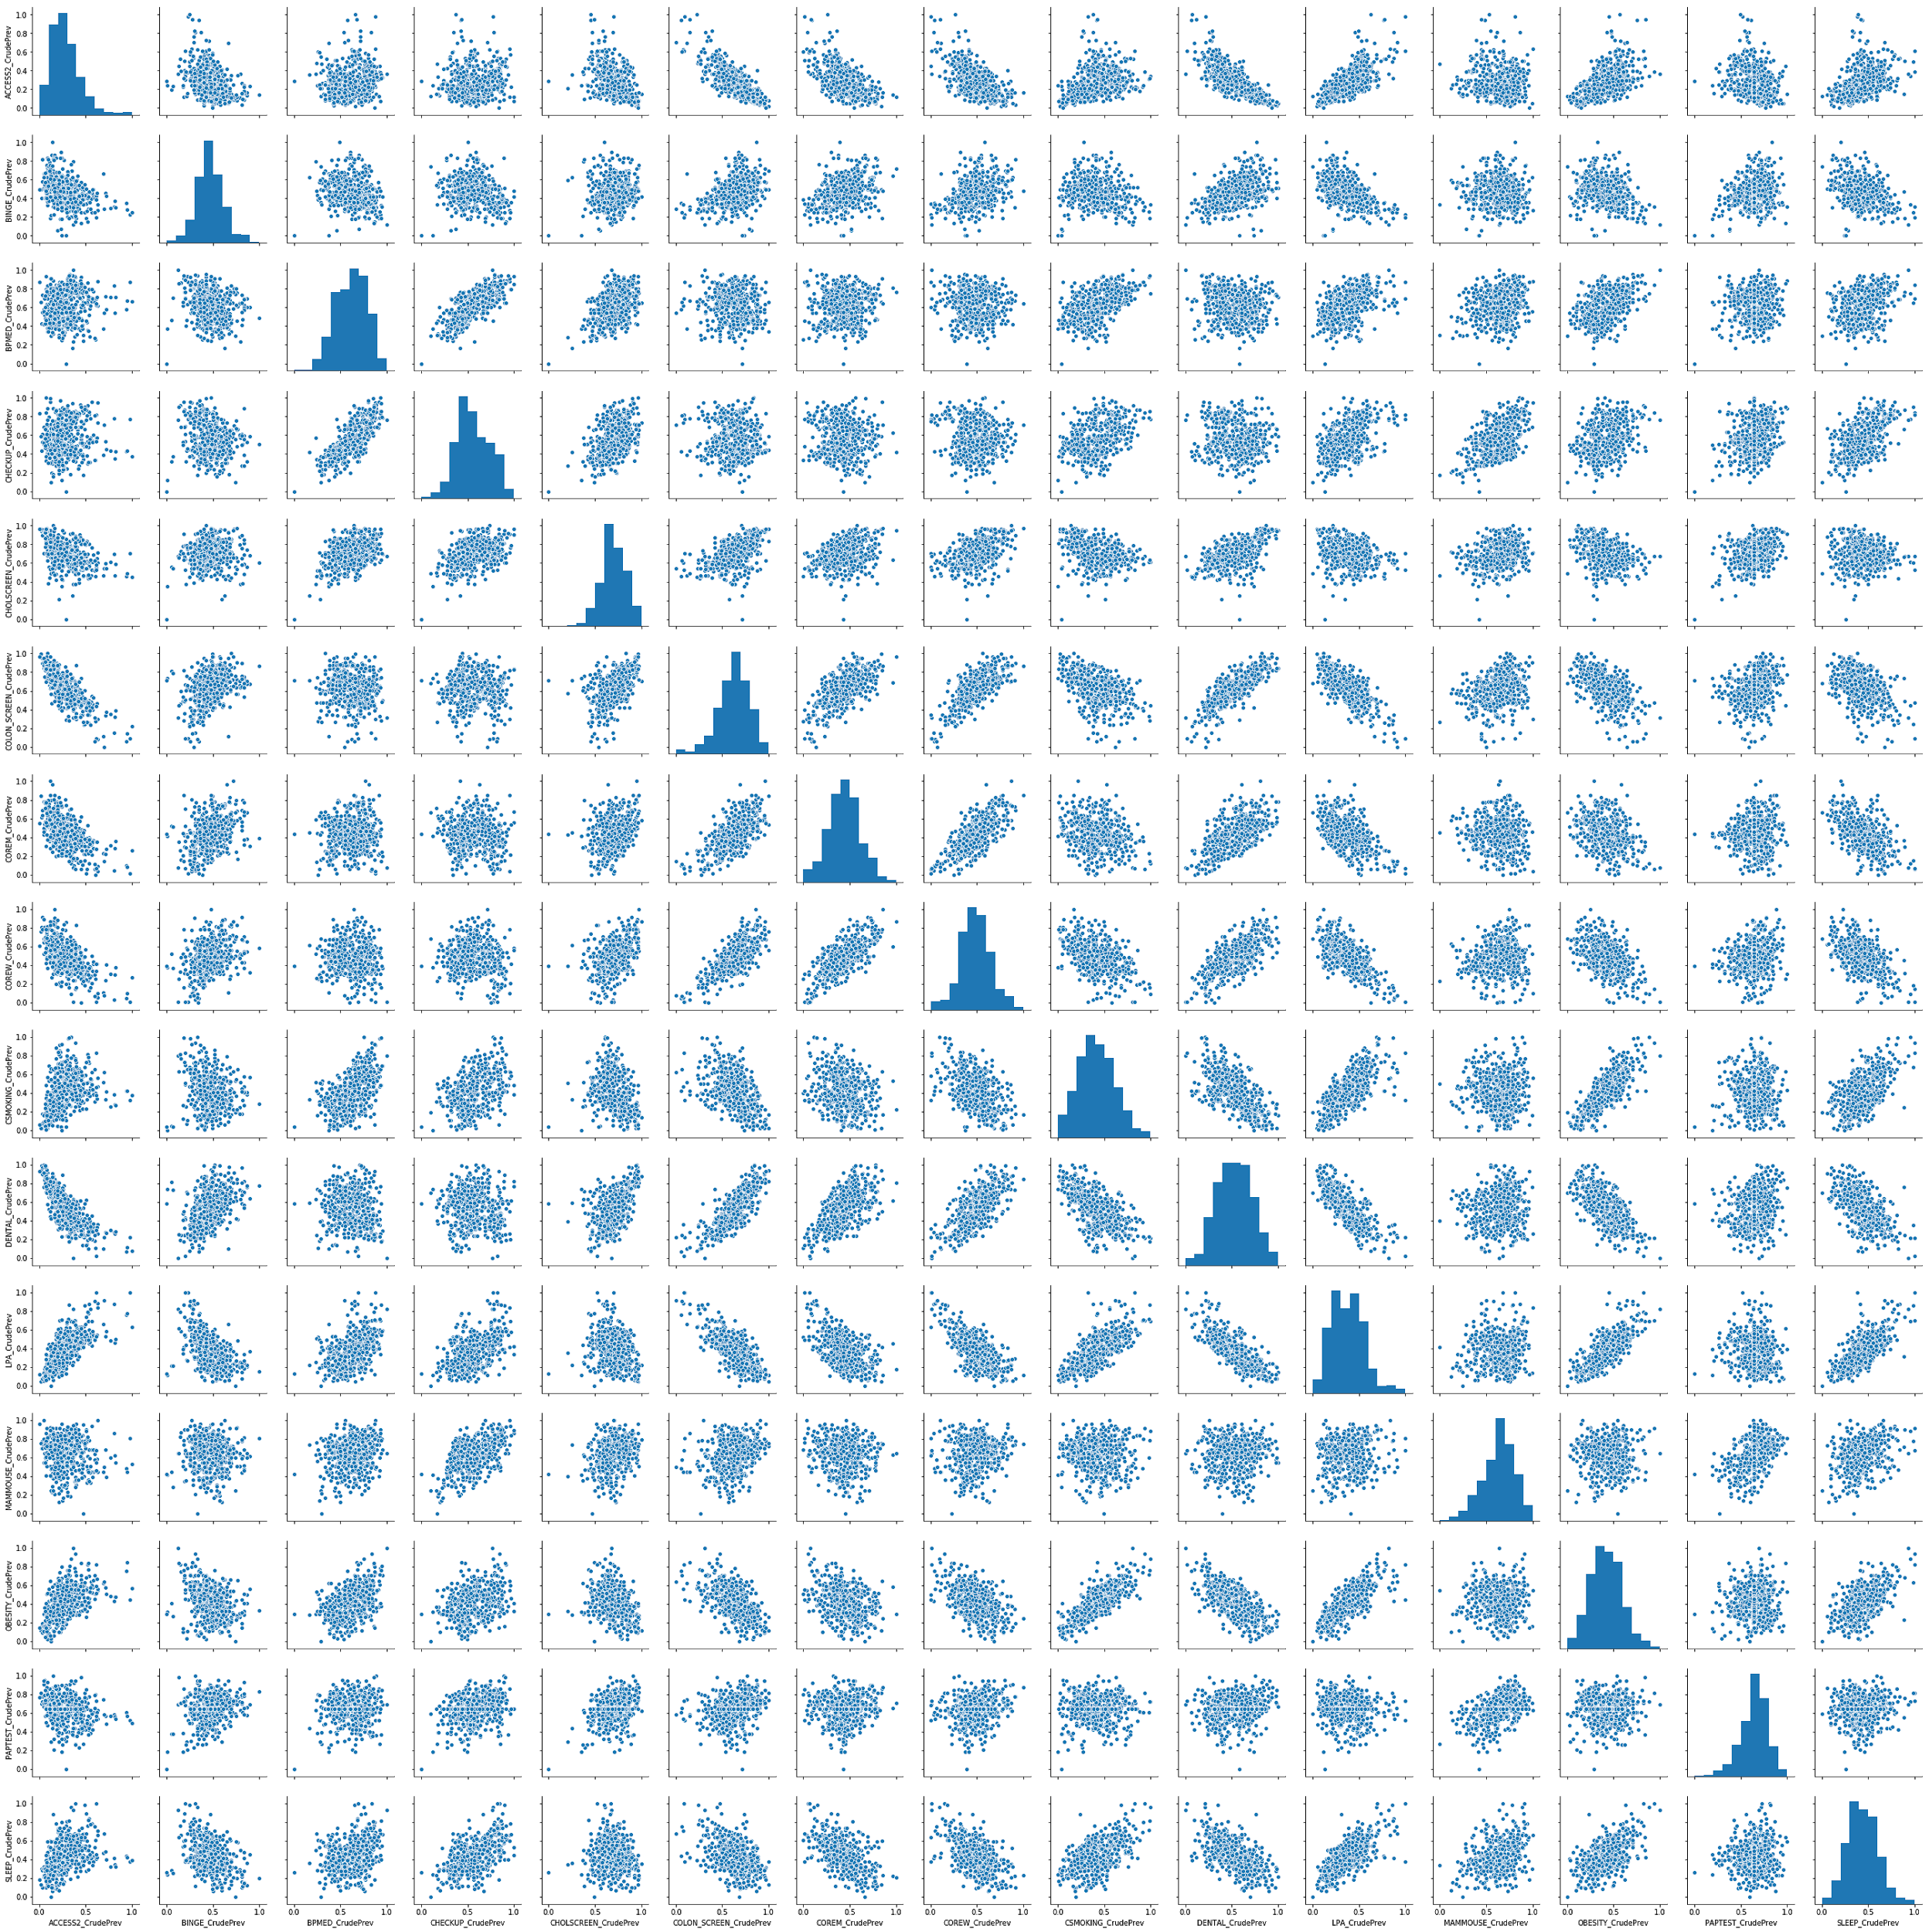
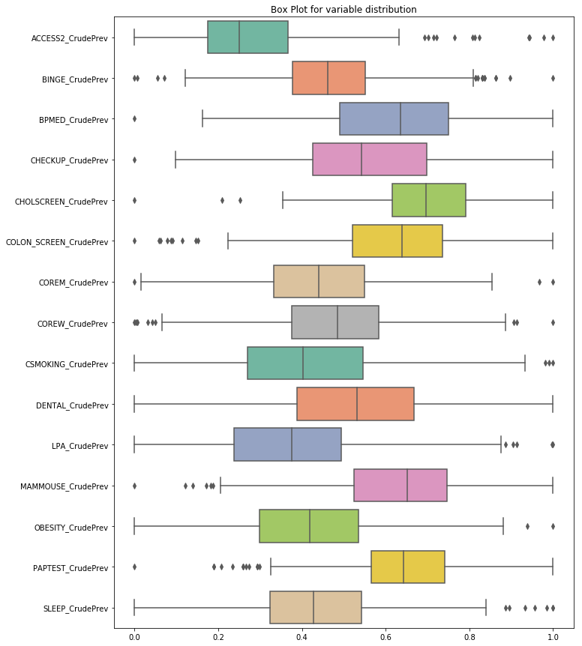
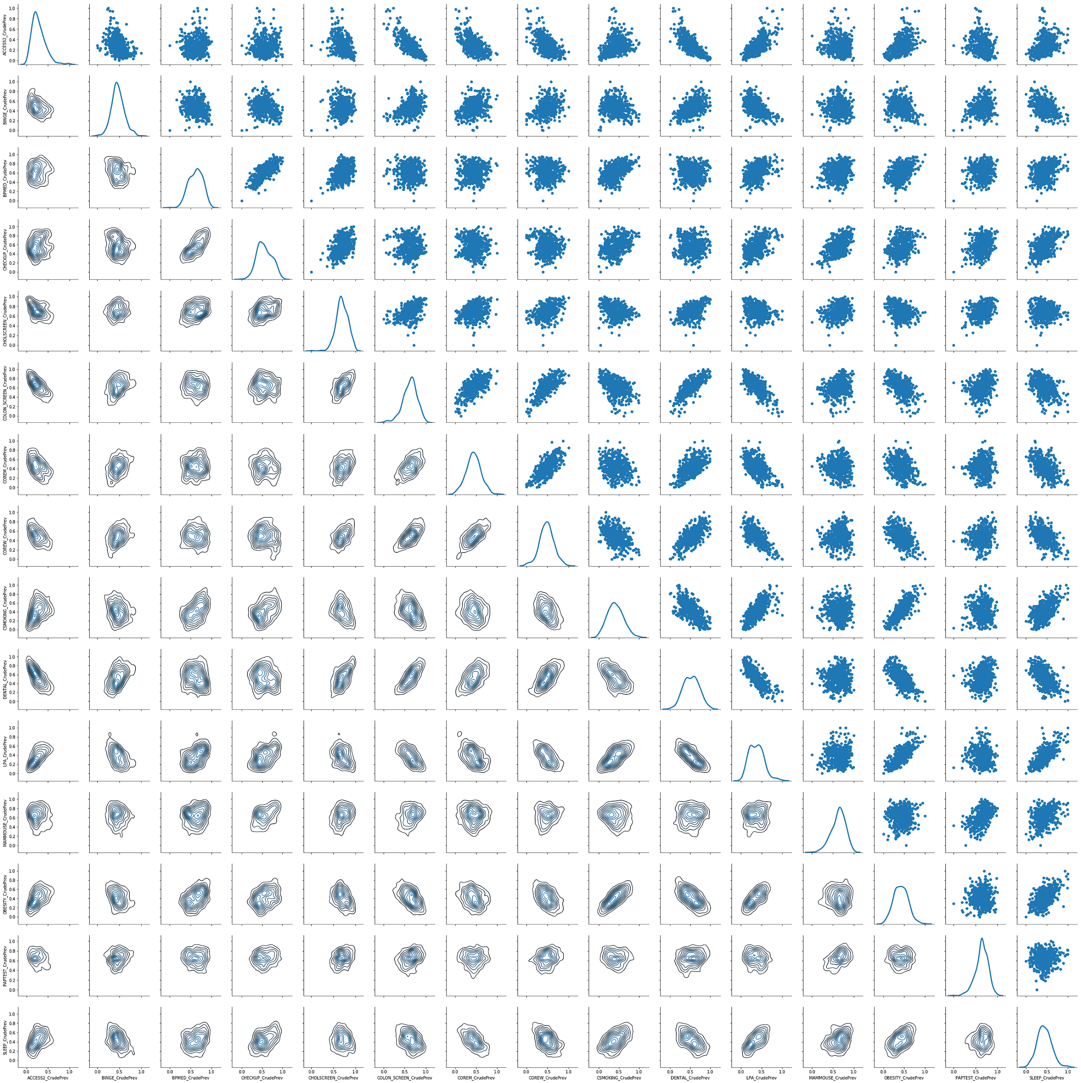
Pairplot
Boxplot
Pairgrid

Slide 8
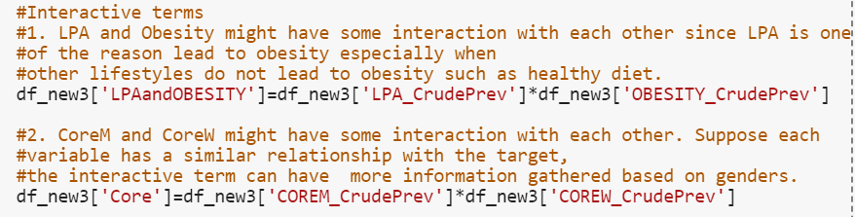
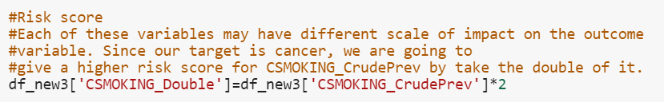
Feature Engineering
Interaction terms
Risk score

Slide 9
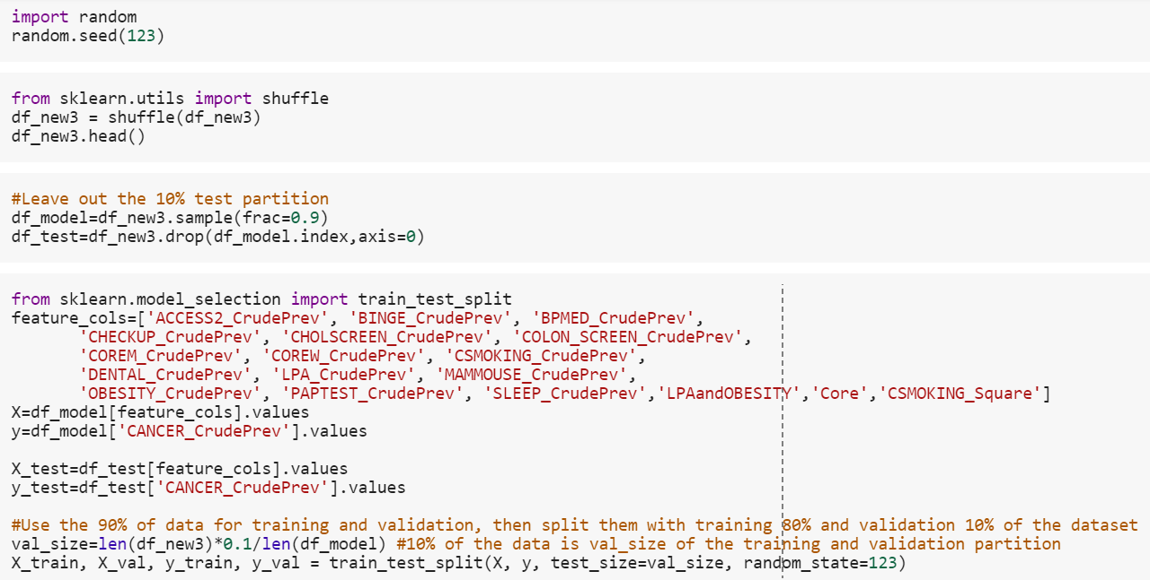
Data Preparation
Code Used

Slide 10
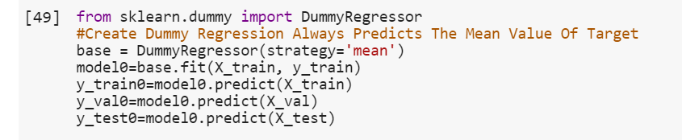
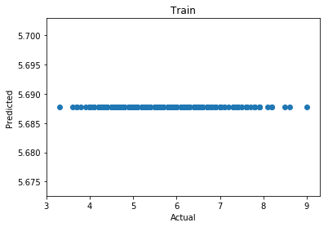
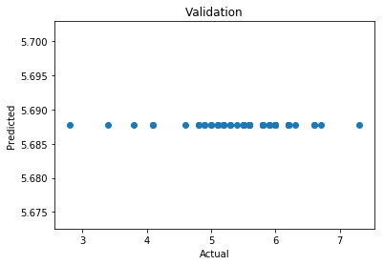
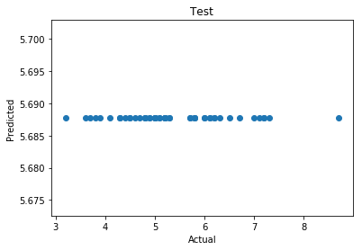
Model Fitting
Model 0 : Baseline Model
Scatterplots

Slide 11
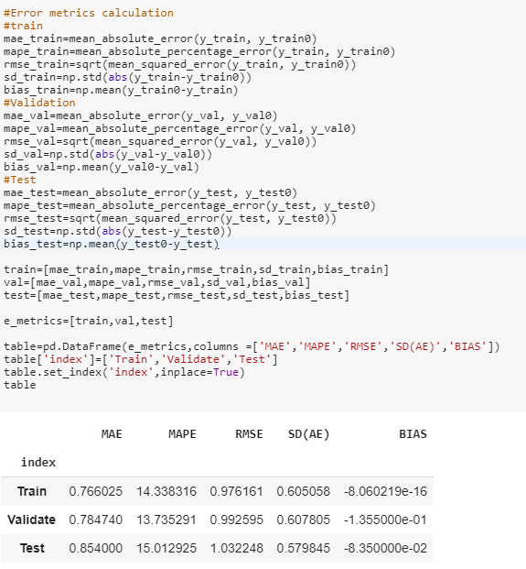
Error Metrics
Comments
Take the simple mean of the target as baseline.
High errors.

Slide 12
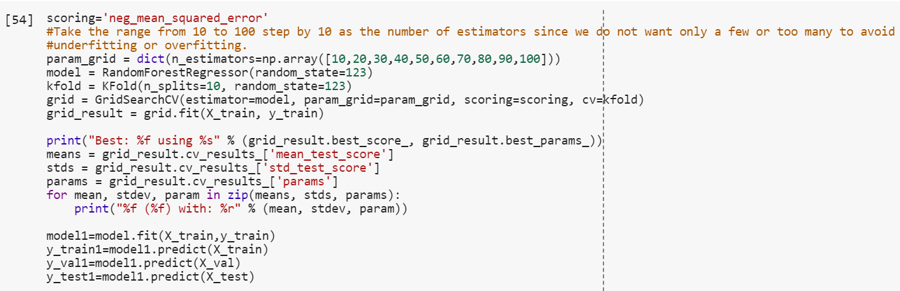
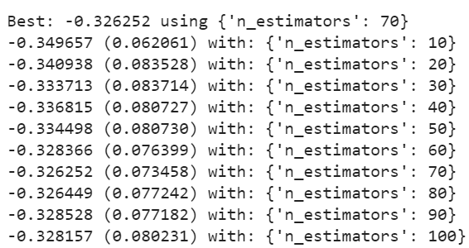
Model 1 : Random Forest
Results

Slide 13
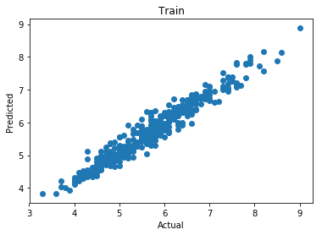
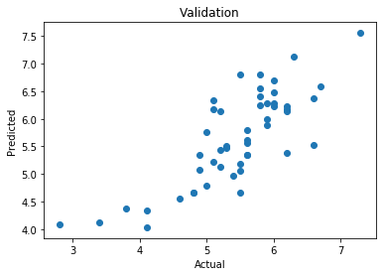
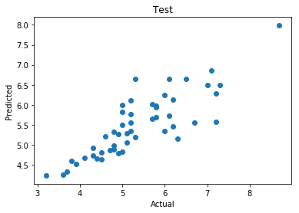
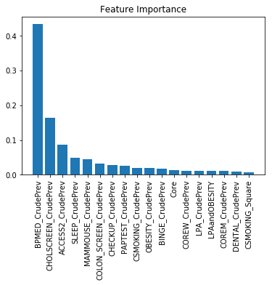
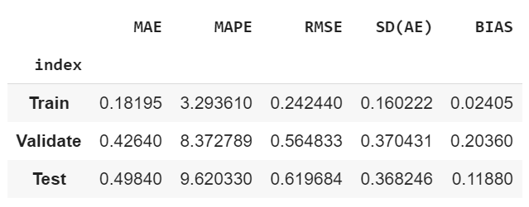
Scatterplot
Error Metrics
Feature Importance

Slide 14
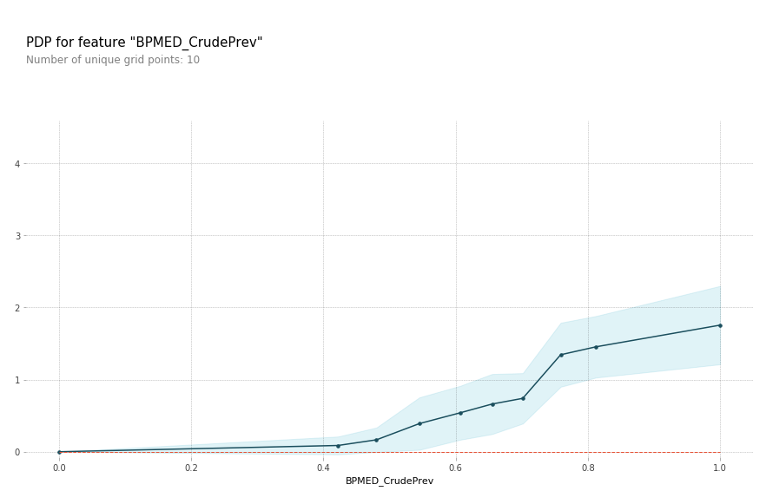
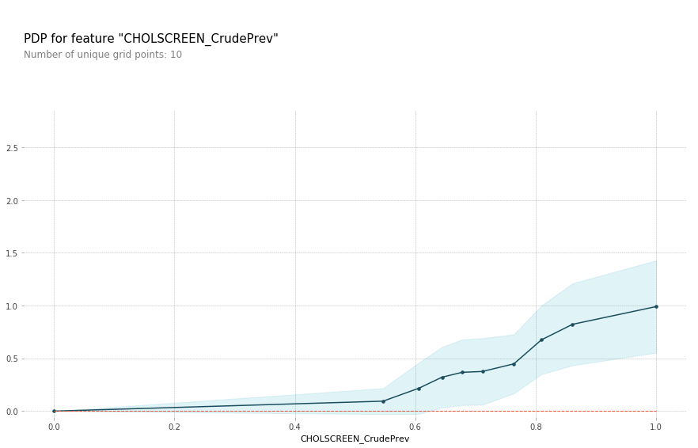
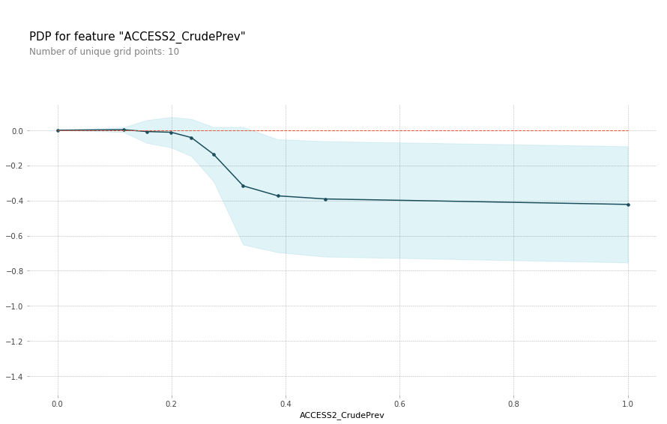
Taking medicine for high blood pressure control and Cholesterol screen positively affect having cancer, while, having insurance negatively affect having cancer.
Partial Dependence Plots

Slide 15
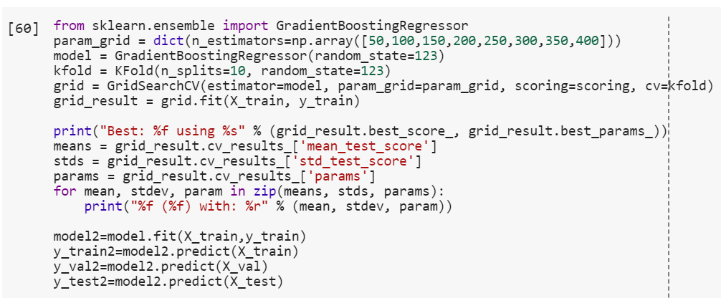
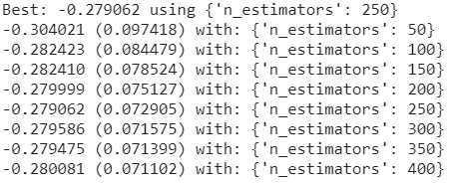
Model 2 :GBM
Results

Slide 16
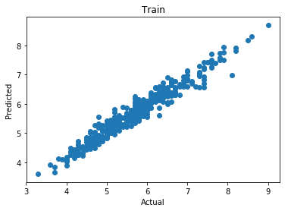
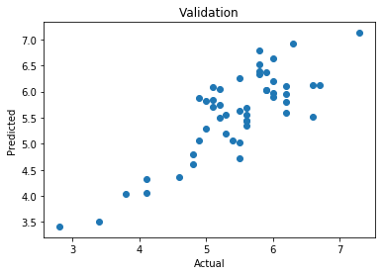
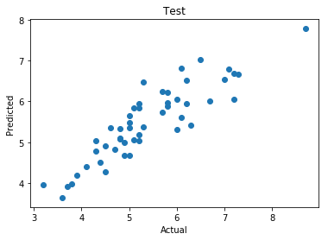
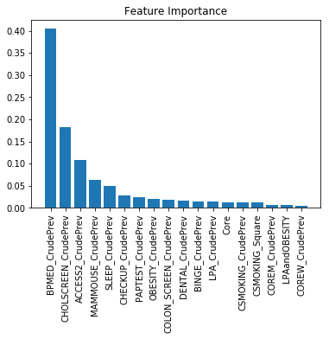
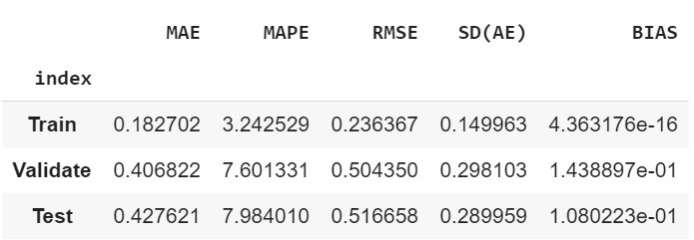
Scatterplot
Error Metrics
Feature Importance

Slide 17
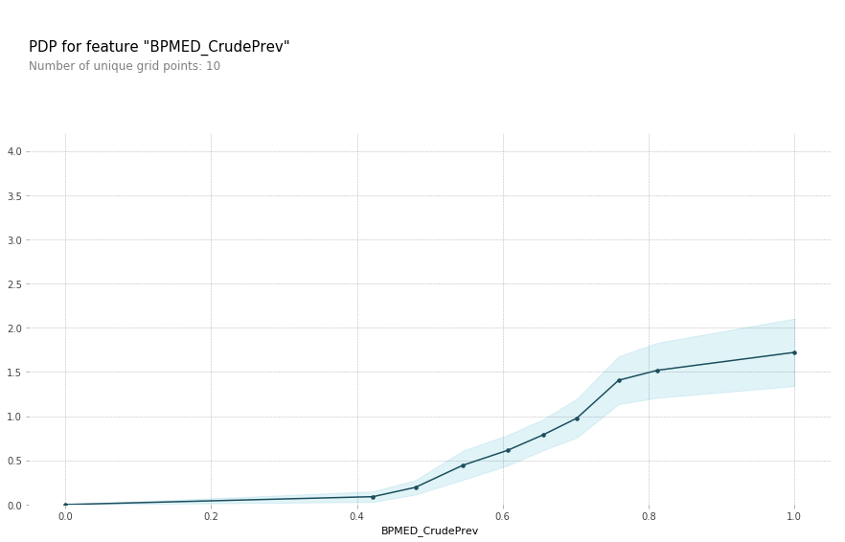
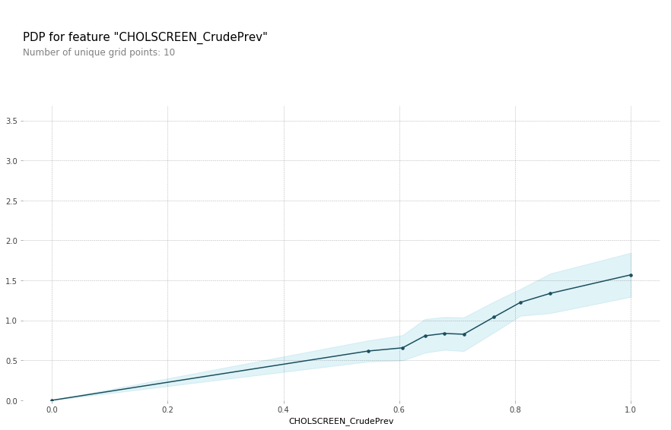
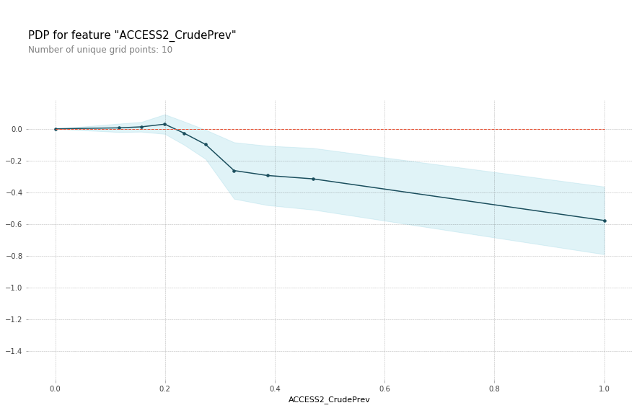
Partial Dependence Plot
BPMED: High Blood Pressure Control
CHOLSCREEN: Cholesterol Screening
ACCESS2: Lack Health Insurance

Slide 18
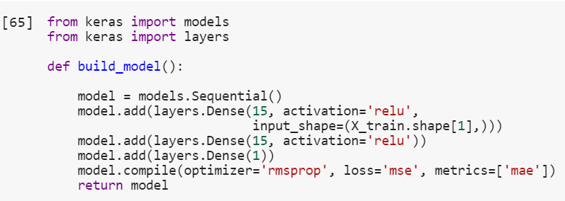
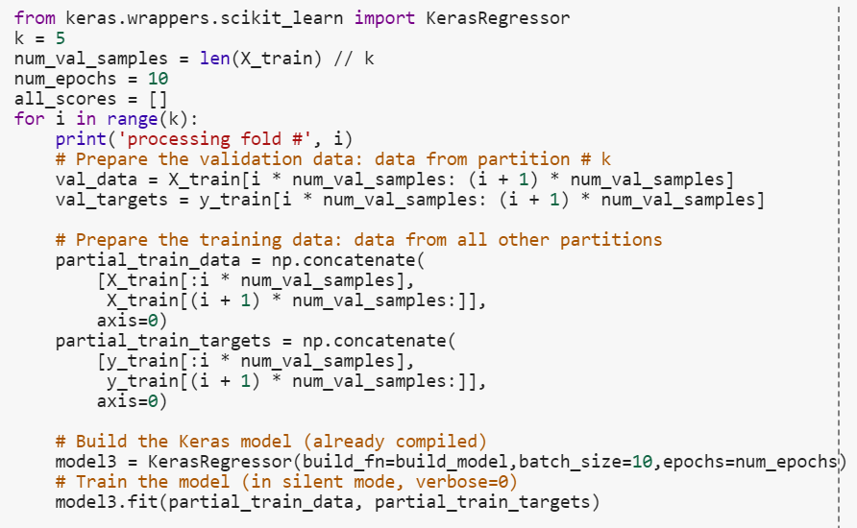
Model 3: Neural Network

Slide 19
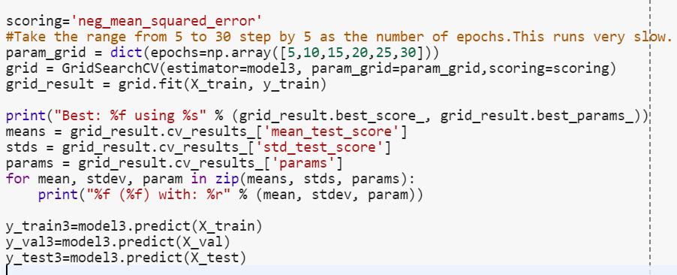
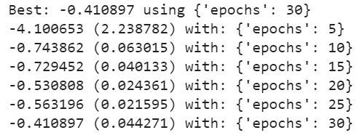
Results

Slide 20
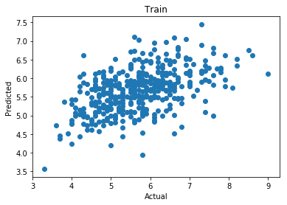
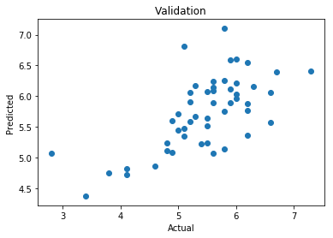
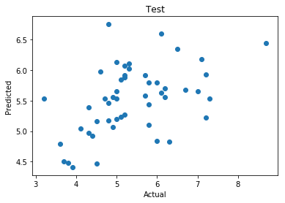
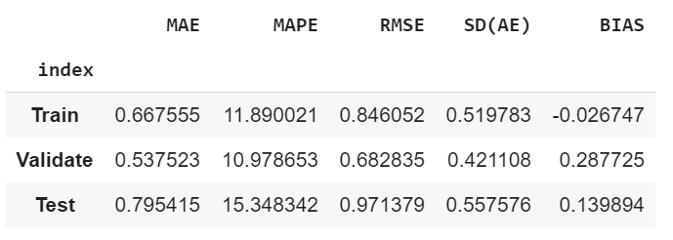
Scatterplot
Error Metrics

Slide 21
Model Comparison
GBM
Random Forest
Neural Network

Slide 22
GBM - Error Metrics
Random Forest - Error Metrics
Neural Networks - Error Metrics
Best Model - GBM

Slide 23
Results and Interpretation
1. The combination of LPA and Obesity is the least important feature.
People who never do physical activity in leisure time and have obesity do not have any impact on predicting cancer in the population..
2. The combination of CoreM and CoreW and the risk score of CSmoking are ranked 8th and 9th.
The clinical preventive services and smoking have influence on preventing and causing cancer in both the male and the female aged more than 65. But compared to that of the top four important feature, the influence of clinical preventive services and smoking are still light.
3. Taking medicine for high blood pressure control, taking cholesterol screening, lack of health insurance and using mammography are the top four important feature.
Controlling high blood pressure, taking cholesterol screening and using mammography strongly contribute to increasing a person's risk of cancer. But people do not own health insurance does not influence predicting cancer.

Slide 24
How we can improve the GBM Model ?
Remove the least three important features DENTAL_CrudePrev, LPA_CrudePrev and LPA and OBESITY, and there are 13 variables, one interaction item and one risk score variable for the new model to predict the percentage of cancer.
Looking for data about specific medicine types people are taking; medical tests results; and binary data for similar variables can definitely improve our models.

Slide 25
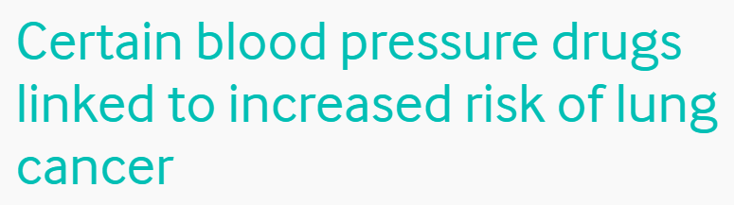
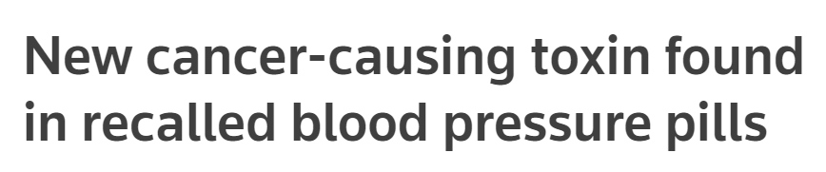
Evidence supporting our model?
https://www.bmj.com/company/newsroom/certain-blood-pressure-drugs-linked-to-increased-risk-of-lung-cancer/
https://www.reuters.com/article/us-health-bloodpressure-fda/new-cancer-causing-toxin-found-in-recalled-blood-pressure-pills-idUSKCN1QI4XF
https://www.northwell.edu/cardiology/news/blood-pressure-medication-may-cause-cancer
Researches indicate that our model prediction is probably on the right direction!

Slide 26
Thank You!
Any questions?

